Slide 1




Credit Card Fraud Detection
TEAM V
Aveline Mariya Shaji, Kyuri Kim, Satya Bharath Reddy Duvvi

Slide 2
INTRODUCTION

Slide 3
Purpose
To use different methods to handle “Unbalanced Data”.
Implement different ML Algorithms and identify the best model for predicting Credit Card Fraud Detection.

Slide 4
SMART Questions
Which ML model performs best in predictive analysis on credit card transaction dataset and detect the fraudulent transactions from the given dataset !?

Slide 5
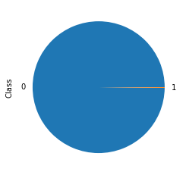
Data
September 2013 data by European cardholders
Unbalanced Data: 492 frauds out of 284,807 transactions (0.172%)
Contains only numerical input variables which are the result of a PCA transformation
Data Source: https://www.kaggle.com/mlg-ulb/creditcardfraud

Slide 6
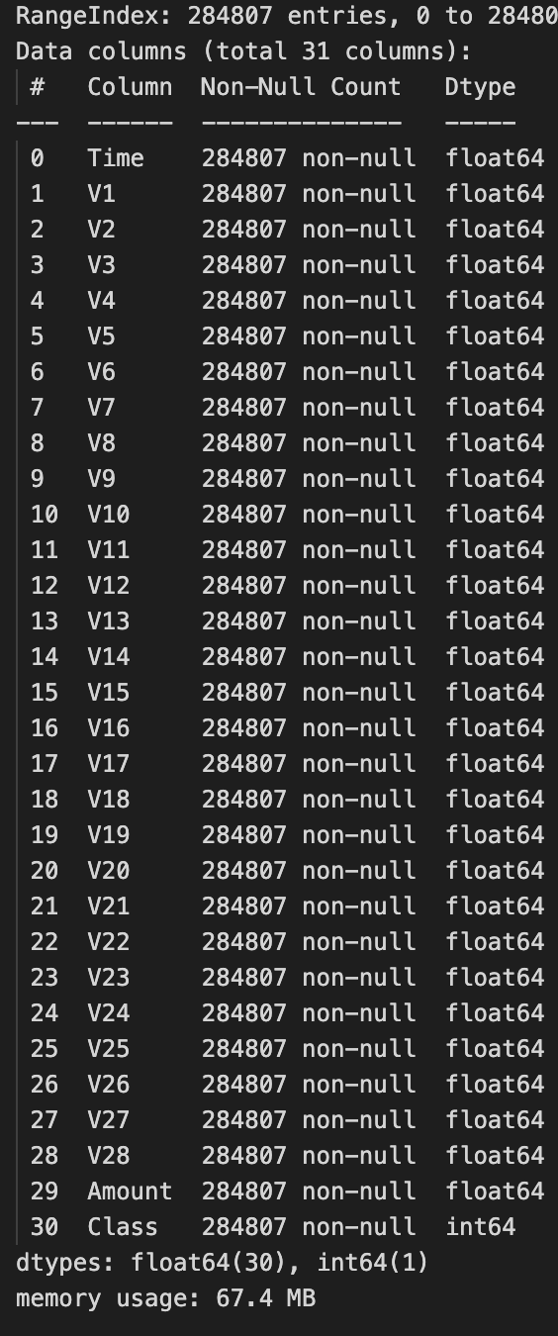
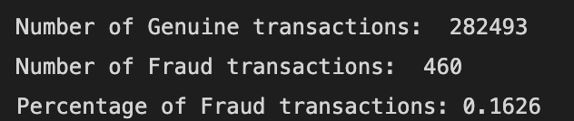
The Blue-Print
Import Data set
Removed missing Values
Checked and deleted Duplicates
Basic EDA
Implemented Balancing Techniques
Used ML Algorithms on final data

Slide 7
DATA VISUALIZATION

Slide 8
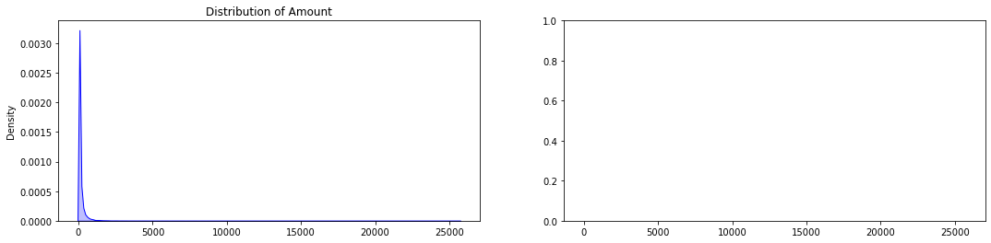
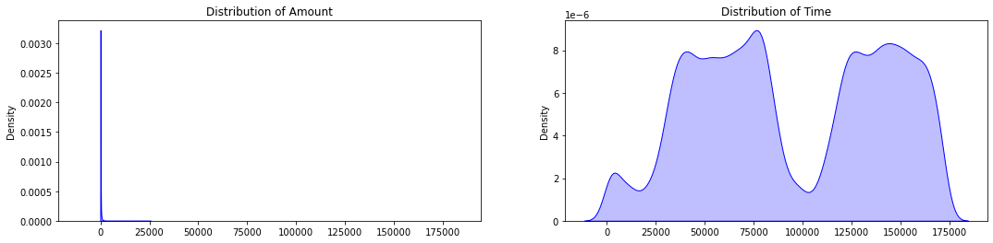
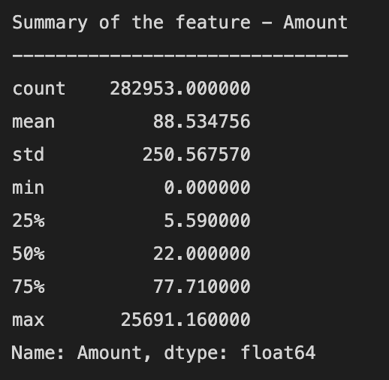
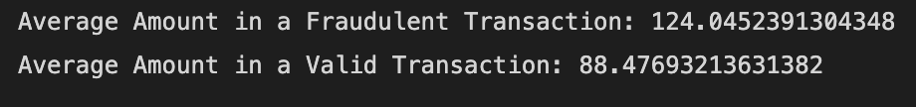
Distribution of Amount & Time

Slide 9
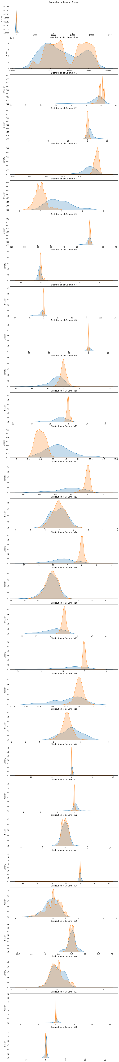

Slide 12
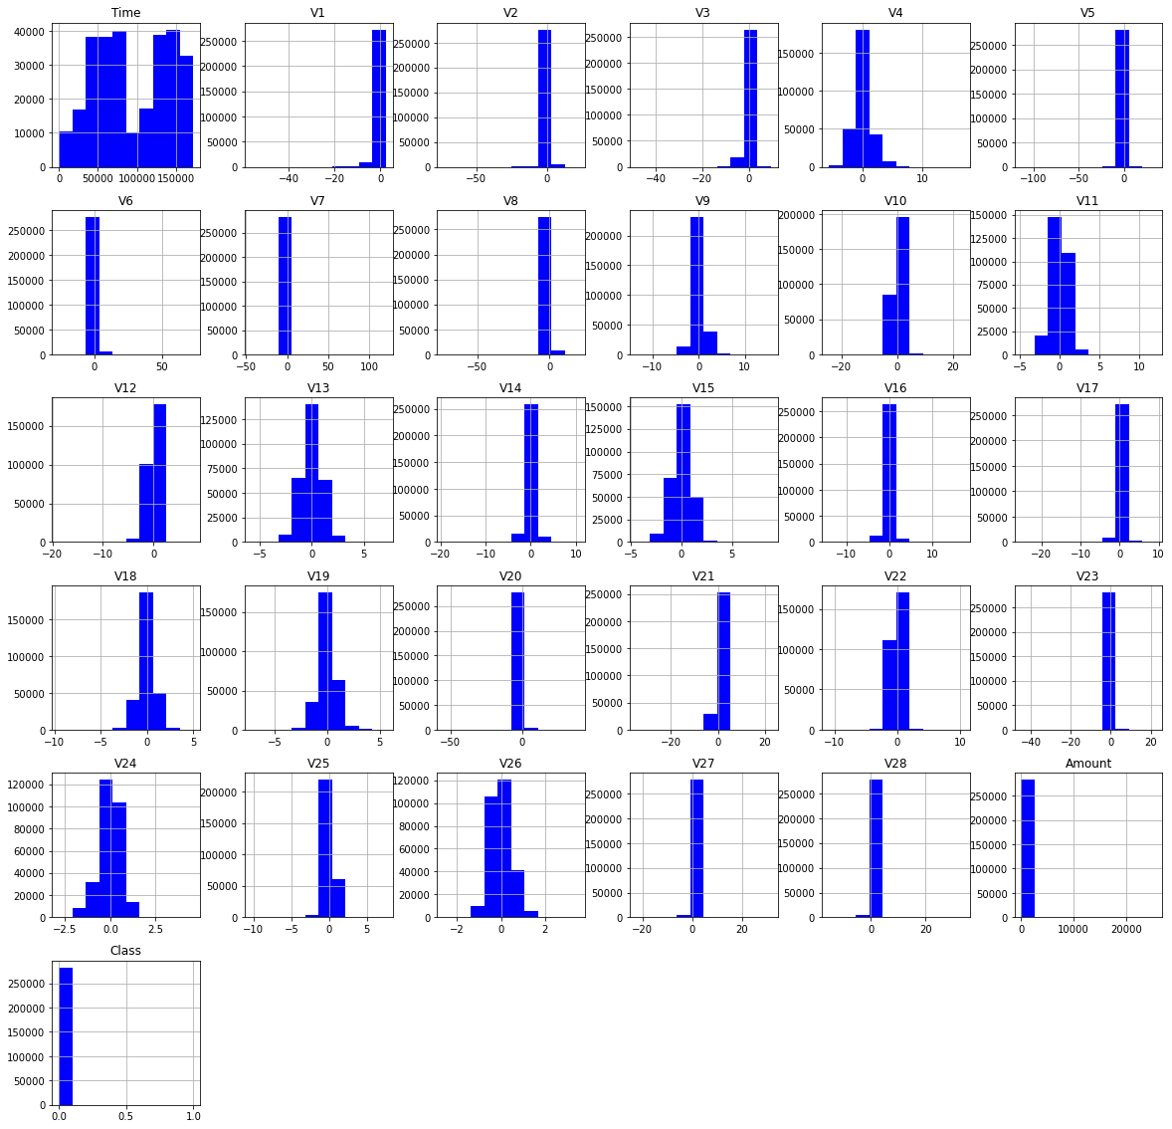
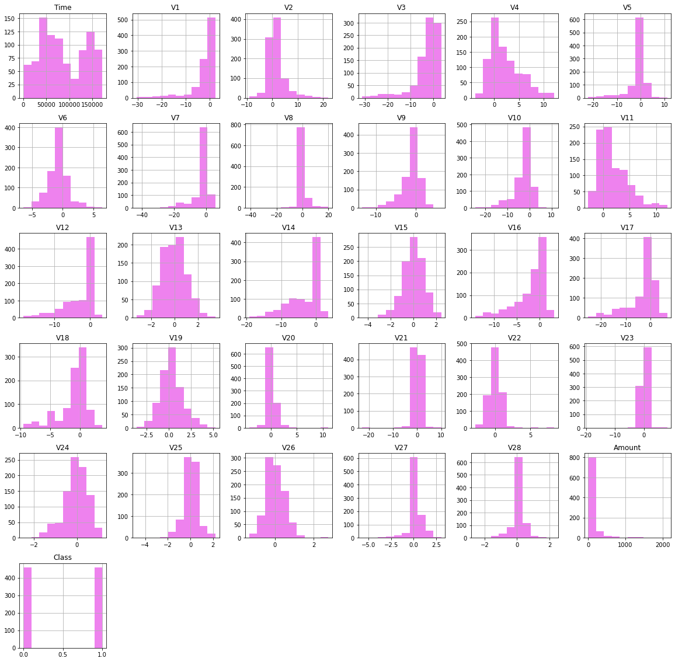
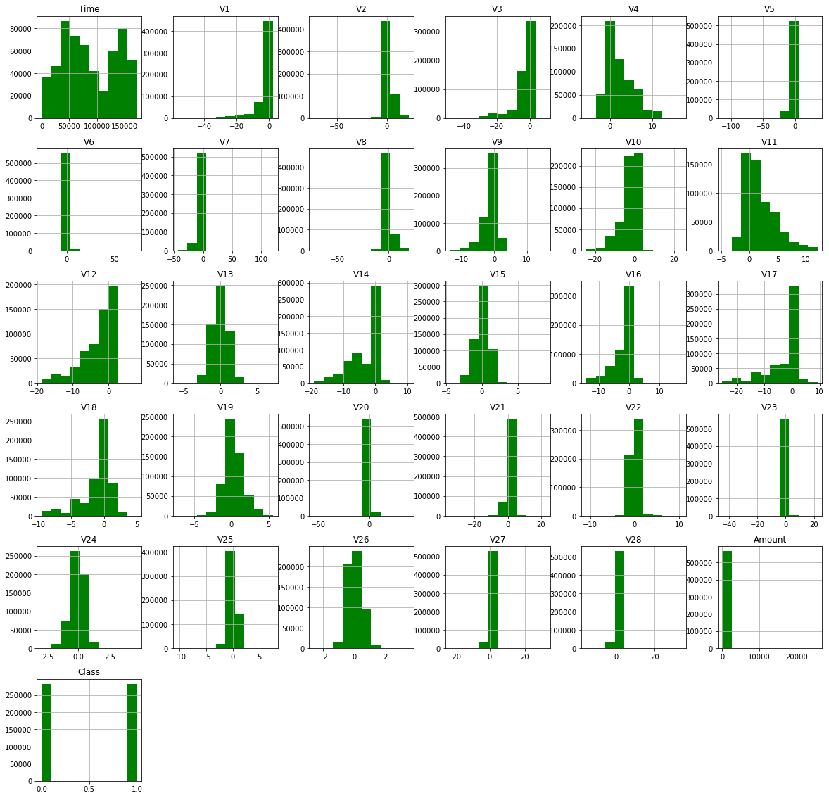
Unbalanced Data
Under Sampling
Over Sampling

Slide 13
ML Models in Unbalanced Data

Slide 14
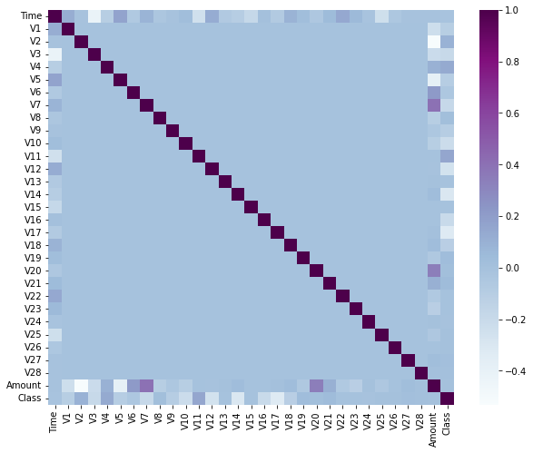
Correlation Matrix

Slide 15
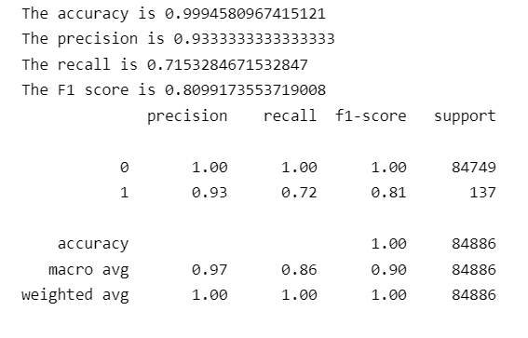
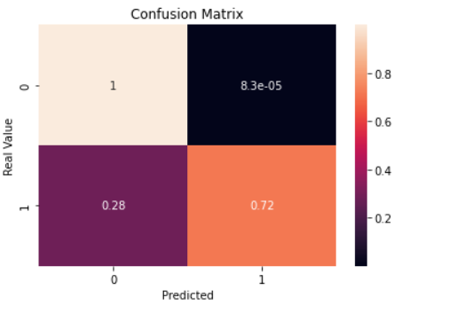
Random Forest Classifier

Slide 16
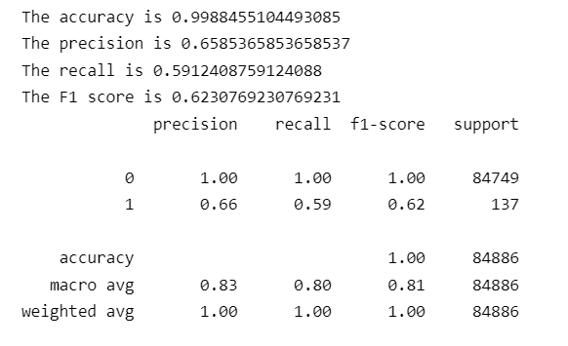
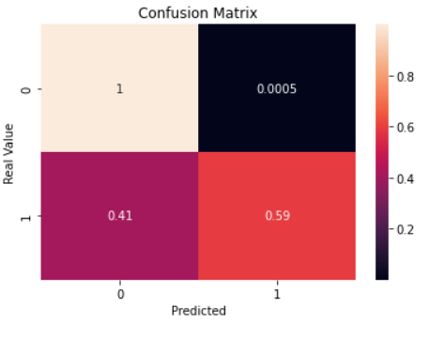
Logistic Regression

Slide 17

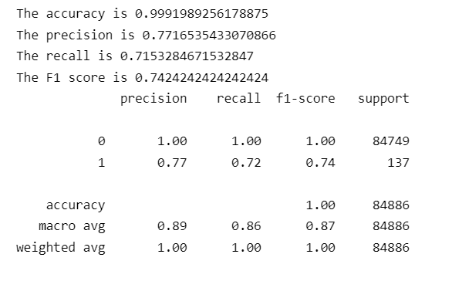
Decision Tree

Slide 18
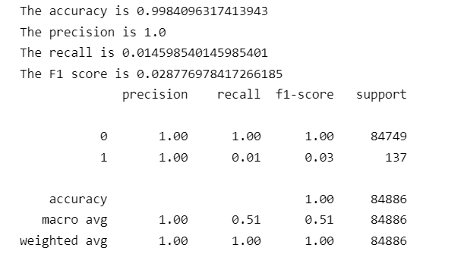
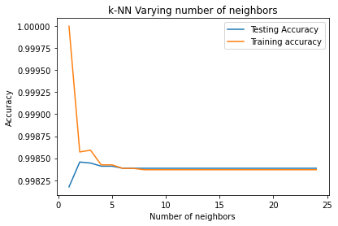
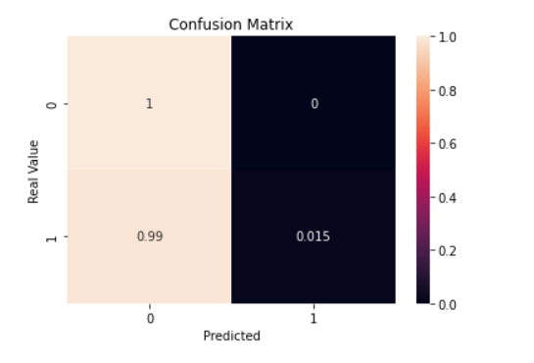
KNN Model

Slide 19
ML Models in Under-Sampling

Slide 20
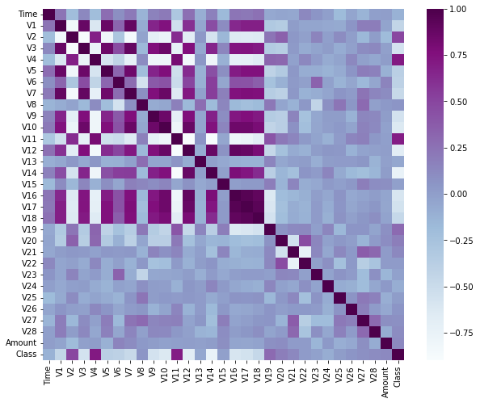
Correlation Matrix

Slide 21
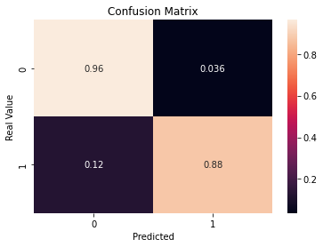
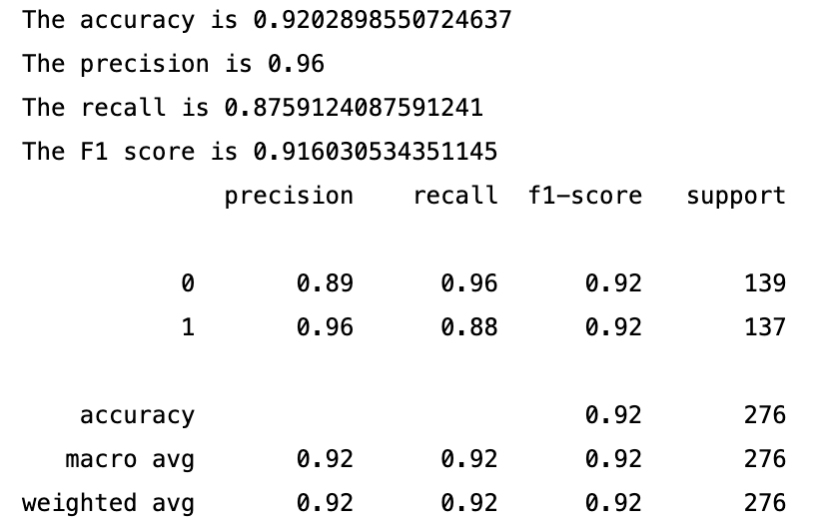
Random Forest Classifier

Slide 22

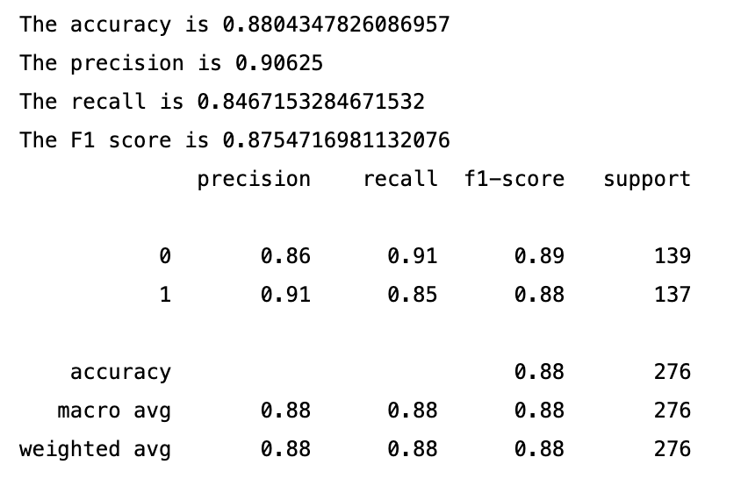
Logistic Regression

Slide 23
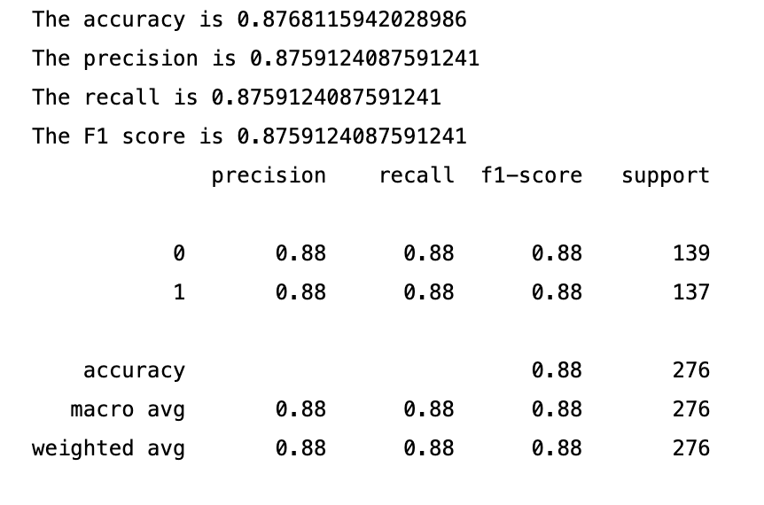
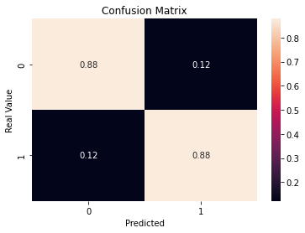
Decision Tree

Slide 24
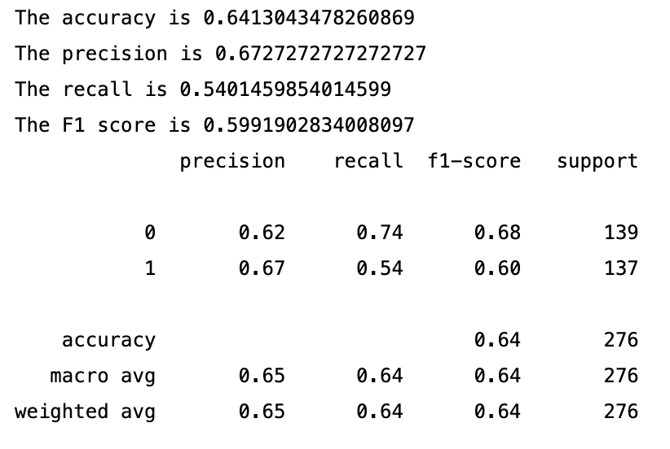
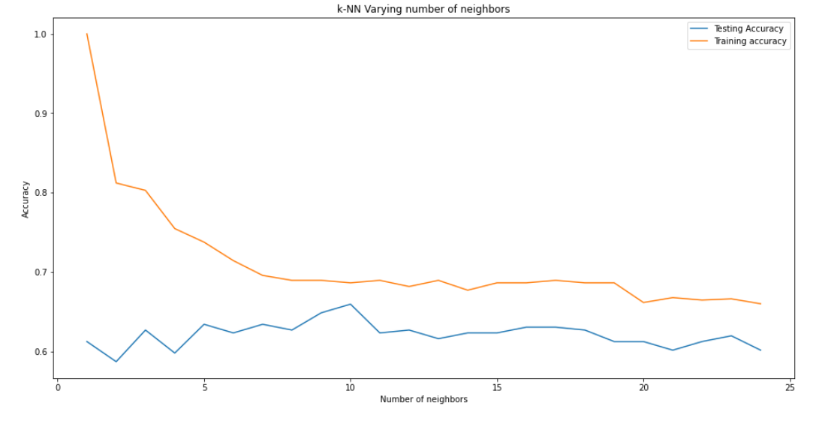
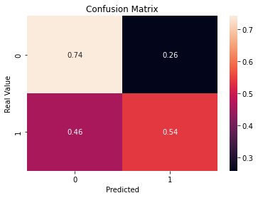
KNN Model

Slide 25
ML Models in Over-Sampling

Slide 26
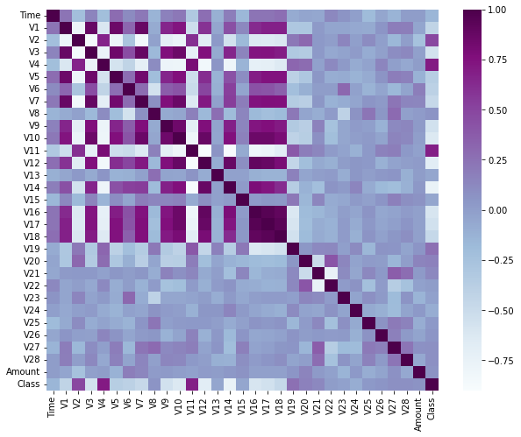
Correlation Matrix

Slide 27
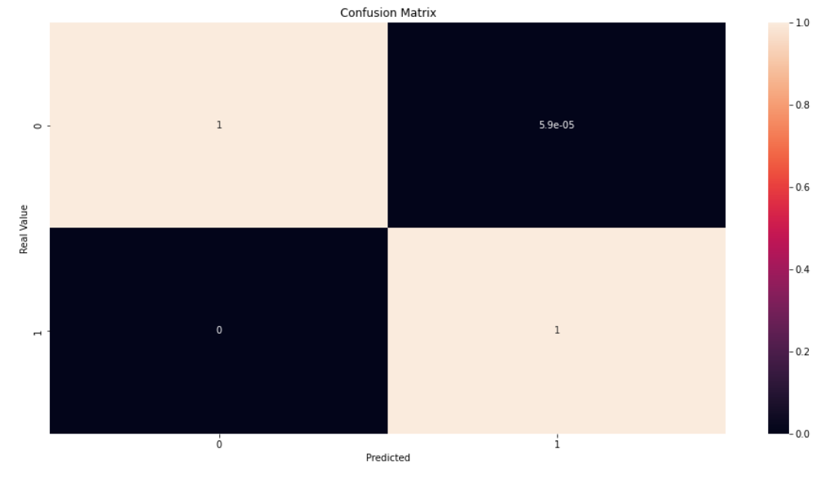
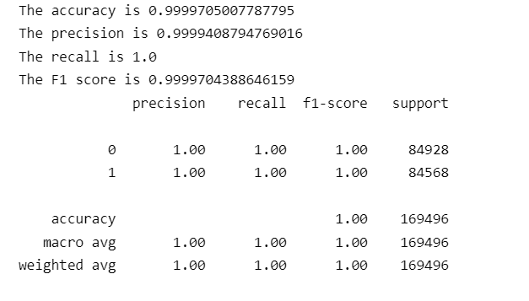
Random Forest Classifier

Slide 28
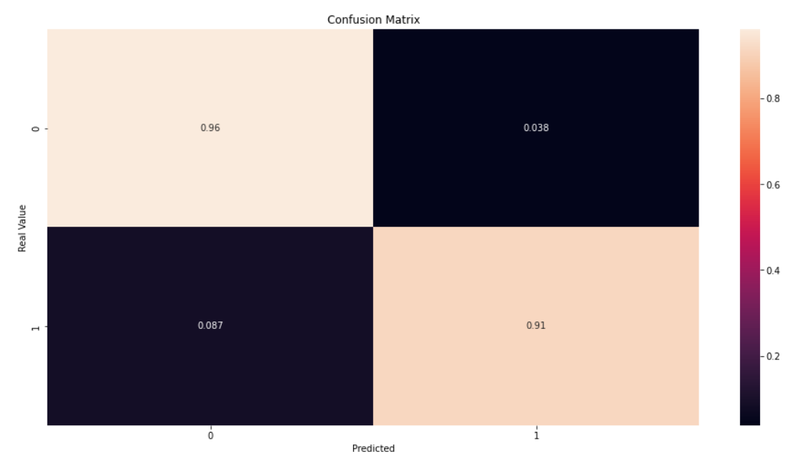
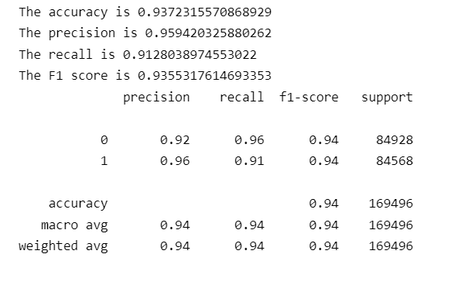
Logistic Regression

Slide 29
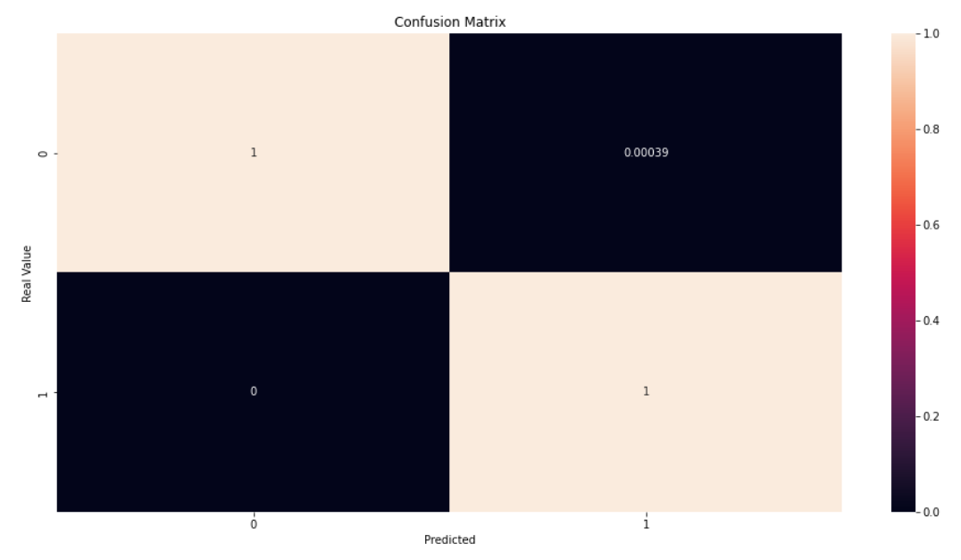
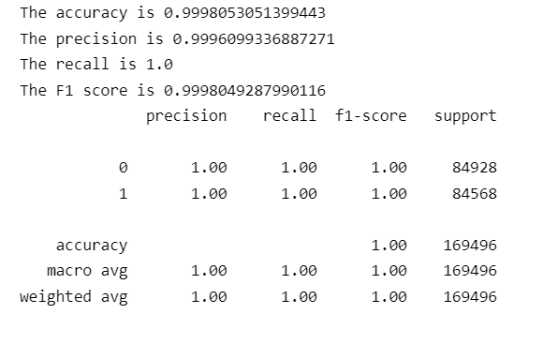
Decision Tree

Slide 30
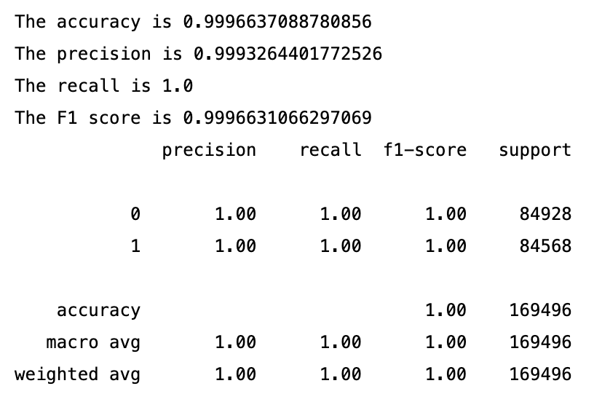
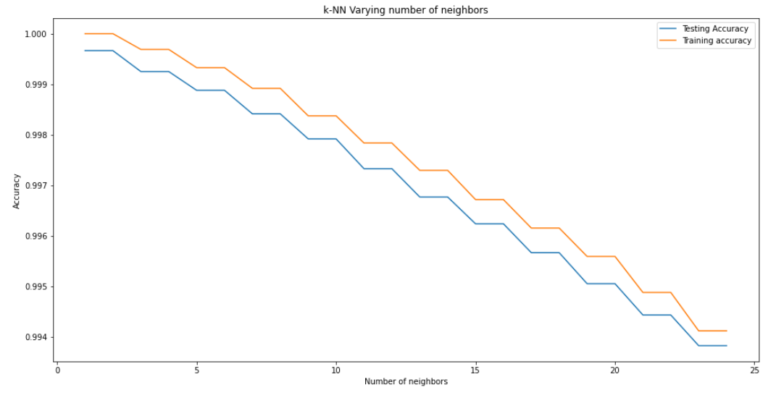
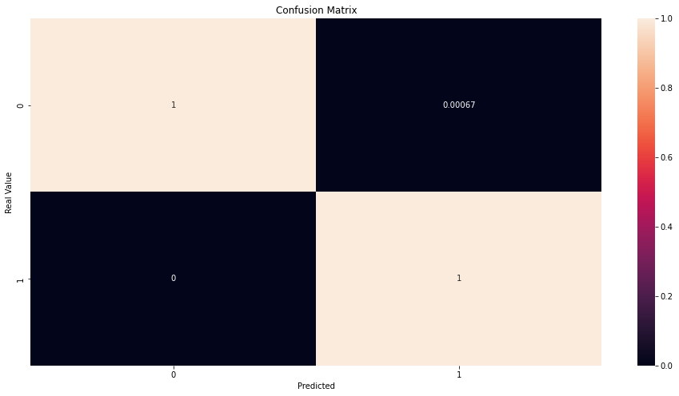
KNN Model

Slide 31
CONCLUSION

Slide 32
ML Model | Method | Accuracy | Precision | Recall | F1 Score
Random Forest Classifier | Unbalanced | 99.94% | 93.33% | 71.53% | 80.99%
 | Under Sampling | 92.03% | 96.00% | 87.59% | 91.60%
 | Over Sampling | 99.99% | 99.99% | 100% | 99.99%
Logistic Regression | Unbalanced | 99.88% | 65.85% | 59.12% | 62.30%
 | Under Sampling | 88.04% | 90.63% | 84.67% | 87.54%
 | Over Sampling | 93.72% | 95.94% | 91.28% | 93.55%
Decision Tree | Unbalanced | 99.91% | 77.16% | 71.53% | 74.24%
 | Under Sampling | 87.68% | 87.59% | 87.59% | 87.59%
 | Over Sampling | 99.99% | 99.96% | 100% | 99.98%
KNN Model | Unbalanced | 99.84% | 100% | 1.45% | 2.87%
 | Under Sampling | 64.13% | 67.28% | 54.01% | 59.91%
 | Over Sampling | 99.96% | 99.93% | 100% | 99.96%

Slide 33
Questions?

